Slide 1
Customer Churn Analysis
Data Engineering Project
Presented By:
Abdullah Awadallah
Mohammad Tulaib

Slide 2
Timeline
Why its important?
Live Demo
Future Work
Introduction
Used tools
Results

Slide 3
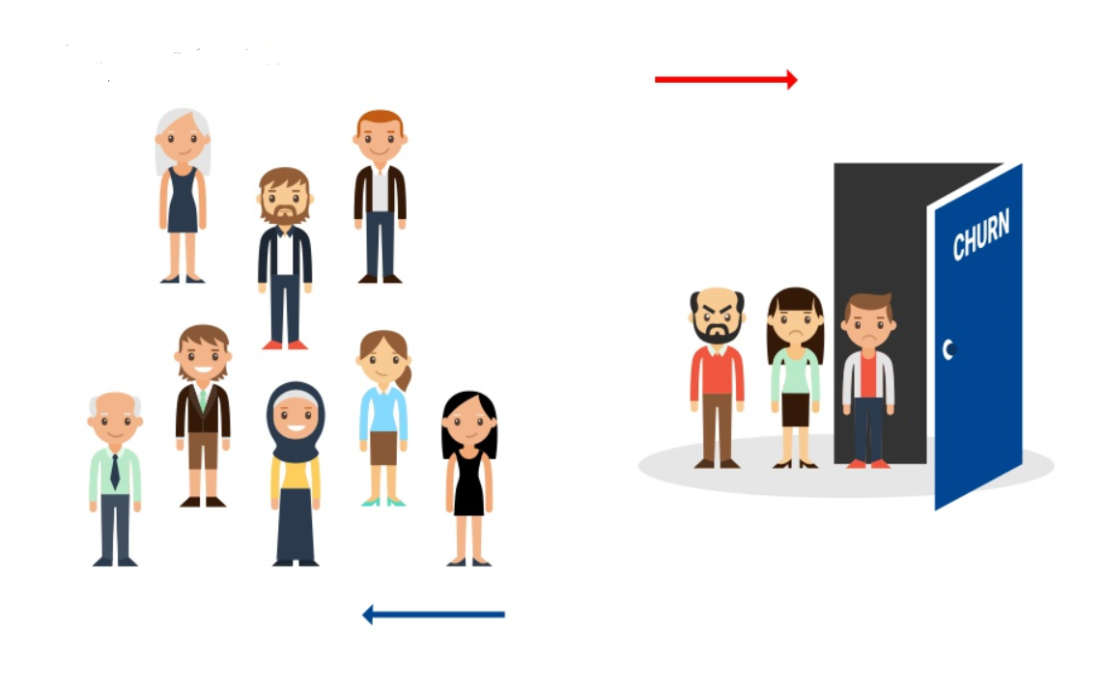
What is Churn ?
It’s the definition of when customer leave !!
When Customer is not satisfied any more from the business
When employee is opening for other vacancies outside the company

Slide 4

Examples
Time Series has many applications such as:
Financial Sector
Ecommerce Sector
04
03
02
01
Telecom
Popular Grocery Stores

Slide 5

Churn Rate is the Most Important Factor for Business
The higher the churn rate, the more your business profit affected
The Churn rate is most important factor for telecommunications, bank and Ecommerce companies

Slide 6

Importance of predicting Churn
losing the existing customers will cost more the organization.
The competition in any market is rising.
An entire customer journey leads to customer churn and not just a few incidents.
Before you want to find solutions to improve your churn rate you should know what is causing it in the first place

Slide 7
How we will Predict ?
We used multi open source tools to analyze the data set and get the needed info from it
Data
Notes:
Ref: https://www.trifacta.com/products/

Slide 8






Slide 9
Results
After analyzing the Data set, we found the below:
19.3% of customers left the company after first 5 month.
A large number of customers using Fiber Optic have left the compnay.
Clients who do not use online security, many of them leave the company.
Many clients who do not use technical support have left the company.
Customers who pay month to month are the most who leave the company.
41.7% of senior citizens left the company.
33% of customers who don't have a partner left the company.
31% of independent customers left the company.
15.4% of dependent customers left the company.
8.7% of customers left the company after the first month.
Churn Analysis

Slide 10
Conclusion
Churn analysis Could help the design makers to make the right calls
01
02
04
03
Summary
Churn prediction is more valuable for companies than targeting new customers

Slide 11
Thank You
Any Question?

